Slide 1
UNIT-1
Fundamentals of ANN
Soft Computing(TCS821)
by
Dr. Manoj Singh Adhikari

Slide 2

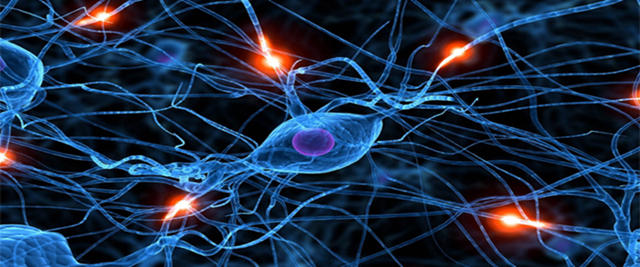
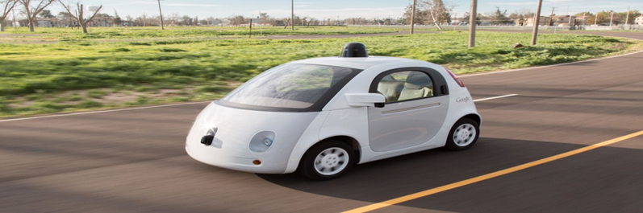

ANN

Slide 3

The human brain is the main control center of the body. It controls thinking, memory, emotions, movement, breathing, heartbeat, and other vital functions. It is protected by the skull and is a key part of the central nervous system.
Basic Components of the Human Brain
1. Cerebrum
Largest part of the brain.
Divided into left and right hemispheres.
Responsible for:
  Thinking and reasoning
  Memory and learning
  Intelligence
  Voluntary actions (walking, writing, speaking)
Contains four lobes: frontal, parietal, temporal, occipital.

Slide 4
2. Cerebellum
Located at the back of the brain, below the cerebrum.
Controls:
  Balance and posture
  Coordination of muscles
  Precision and smooth movement
Important for motor learning.
3. Brainstem
Connects the brain to the spinal cord.
Controls involuntary activities such as:
  Breathing
  Heartbeat
  Blood pressure
  Swallowing
Made up of:
  Midbrain
  Pons
  Medulla oblongata

Slide 5
4. Thalamus
Acts as a relay station.
Transfers sensory information (except smell) to the cerebrum.
Helps in alertness and consciousness.
5. Hypothalamus
Maintains body balance (homeostasis).
Controls:
  Body temperature
  Hunger and thirst
  Sleep cycle
  Hormone secretion (via pituitary gland)

Slide 6
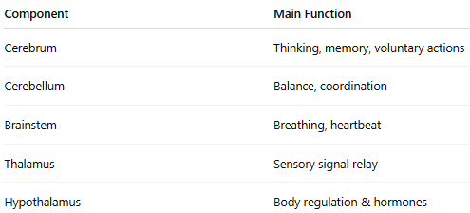
Basic Components of the Human Brain

Slide 7

Aspect | Hard Computing | Soft Computing
Definition | Hard computing is based on precise, exact, and deterministic algorithms. | Soft computing is based on approximation, uncertainty, and tolerance to imprecision.
Nature of Solution | Produces exact and accurate results. | Produces approximate but acceptable results.
Logic Used | Uses classical logic (Boolean logic: true/false). | Uses fuzzy logic, probabilistic reasoning, and learning methods.
Input Requirements | Requires complete, precise, and accurate input data. | Can work with incomplete, noisy, or uncertain data.
Flexibility | Less flexible and rigid in nature. | Highly flexible and adaptive.
Learning Ability | No learning capability. | Has learning and self-adaptation capability.
Examples | Conventional algorithms, numerical methods, digital computers. | Fuzzy Logic, Neural Networks, Genetic Algorithms, Machine Learning.
Applications | Banking calculations, compiler design, scientific computations. | Pattern recognition, speech recognition, robotics, control systems.

Slide 8
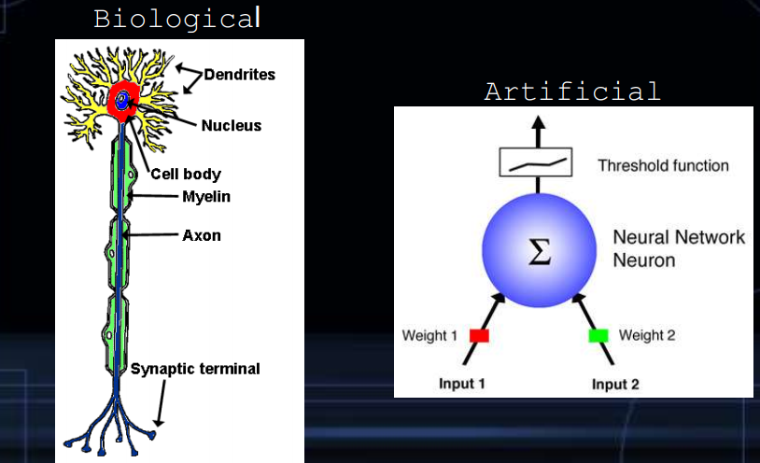
Biological approach to AI

Slide 9
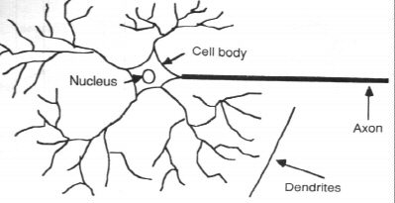
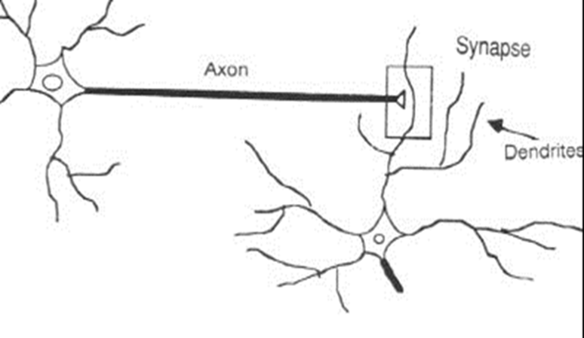
Natural neurons
The information transmission happens at the synapses.

Slide 10
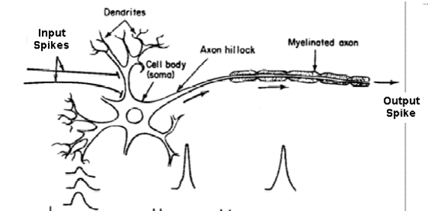
Basic Input-Output Transformation

Slide 11
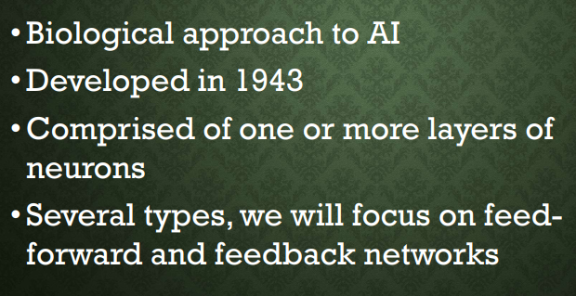
BASICS OF NEURAL NETWORK

Slide 12
From Biological to Artificial Neurons
The Neuron - A Biological Information Processor
dendrites - the receivers
soma - neuron cell body (sums input signals)
axon - the transmitter
synapse - point of transmission
neuron activates after a certain threshold is meet
Learning occurs via electro-chemical changes in effectiveness of synaptic junction.

Slide 13
Introduction
Artificial Neural Networks (ANN)
  Information processing inspired by biological nervous systems
  ANN is composed of a system of neurons connected by synapses
  ANN learn by
    Adjust synaptic connections between neurons

Slide 14
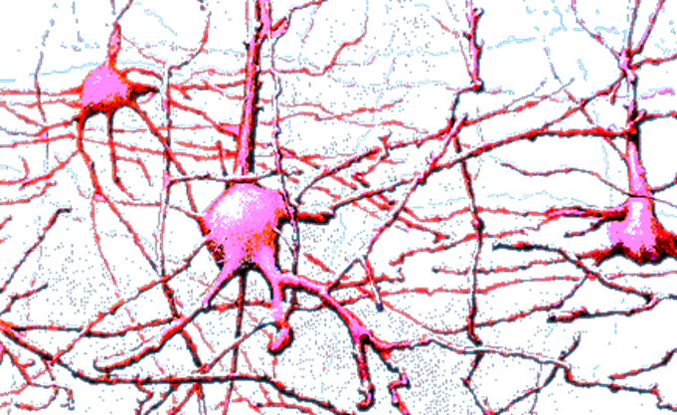
Biological Neuron
Animals are able to react adaptively to changes in their external and internal environment, and they use their nervous system to perform these behaviours.
An appropriate model/simulation of the nervous system should be able to produce similar responses and behaviours in artificial systems.

Slide 15
Artificial neural networks
An Artificial Neural Network (ANN) is an information processing paradigm that is inspired by the biological nervous systems, such as the human brain’s information processing mechanism.
The key element of this network is the novel structure of the information processing system. It is composed of a large number of highly interconnected processing elements (neurons) working in unison to solve specific problems.
An NN is configured for a specific application, such as pattern recognition or data classification, through a learning process. Learning in biological systems involves adjustments to the synaptic connections that exist between the neurons.

Slide 16
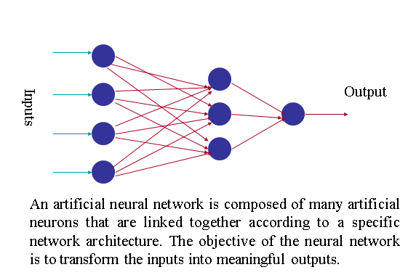
Artificial neural networks

Slide 17
Artificial neural networks
Tasks to be solved by Artificial Neural Networks:-
Controlling the movements of a robot based on self-perception and other information (e.g., visual information)
Deciding the category of potential food items (e.g., edible or non-edible) in an artificial world
Recognizing a visual object (e.g., a familiar face)
Predicting where a moving object goes, when a robot wants to catch it.

Slide 18
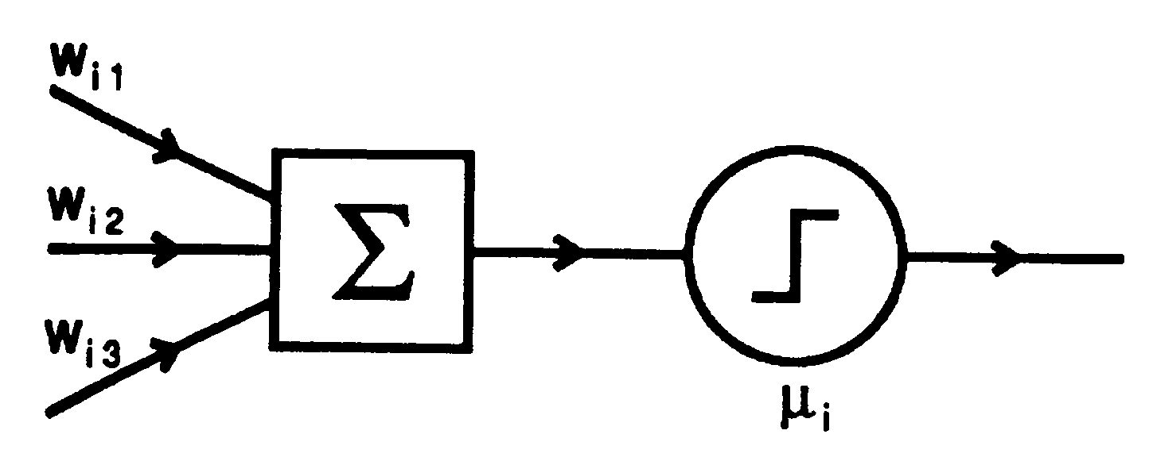
Attributes of neuron
  m binary inputs and 1 output (0 or 1)
  Synaptic weights w_{ij}
  Threshold μ_{i}

Slide 19
An Artificial Neuron - The Perceptron
simulated on hardware/software
input connections - the receivers
node, and unit simulates neuron body
output connection - the transmitter
activation function employs a threshold or bias
connection weights act as synaptic junctions
Learning occurs via changes in value of the connection weights.

Slide 20
Basic function of neuron is to sum inputs, and produce output, given sum is greater than threshold
ANN node produces an output as follows:
1. Multiplies each component of the input pattern by the weight of its connection
2. Sums all weighted inputs
3. Transforms the total weighted input into the output using the activation function

Slide 21
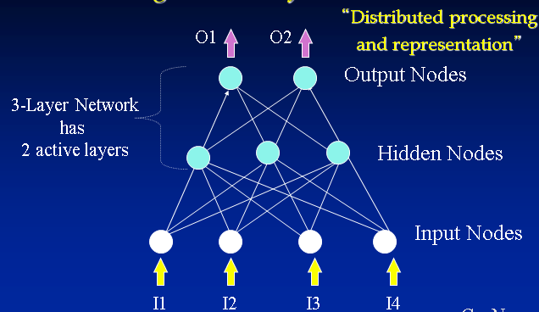

Slide 22
Behaviour of an artificial neural network to any particular input depends upon:-
structure of each node (activation function)
structure of the network (architecture)
weights on each of the connections

Slide 23
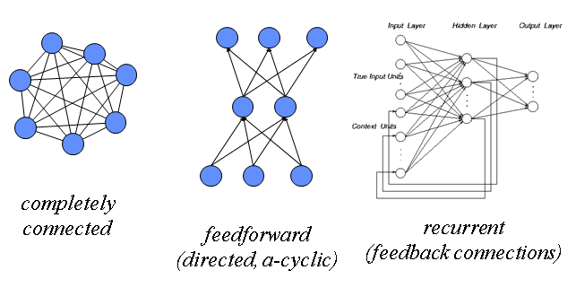
Topologies of Neural Networks

Slide 24
Neuron Model
Neuron collects signals from dendrites
Sends out spikes of electrical activity through an axon, which splits into thousands of branches.
At end of each brand, a synapses converts activity into either exciting or inhibiting activity of a dendrite at another neuron.
Neuron fires when exciting activity surpasses inhibitory activity
Learning changes the effectiveness of the synapses

Slide 25
Neuron Model
Natural neurons

Slide 26
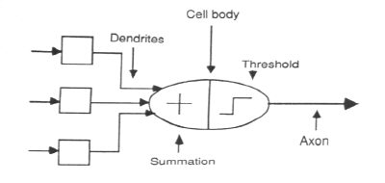
Neuron Model
Abstract neuron model:

Slide 27
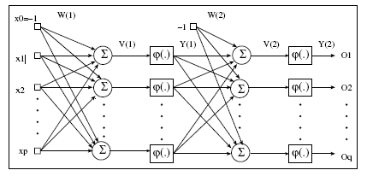
ANN Forward Propagation

Slide 28
ANN Forward Propagation
Bias Nodes
  Add one node to each layer that has constant output
Forward propagation
  Calculate from input layer to output layer
  For each neuron:
    Calculate weighted average of input
    Calculate activation function

Slide 29
History
1943: McCulloch–Pitts “neuron”
  Started the field
1962: Rosenblatt’s perceptron
  Learned its own weight values; convergence proof
1969: Minsky & Papert book on perceptrons
  Proved limitations of single-layer perceptron networks
1982: Hopfield and convergence in symmetric networks
  Introduced energy-function concept
1986: Backpropagation of errors
  Method for training multilayer networks
Present: Probabilistic interpretations, and spiking networks

Slide 30
History
1943: McCulloch and Pitts model neural networks based on their understanding of neurology.
  Neurons consists simple logic functions:
    a or b
    a and b

Slide 31
History
Perceptron (Rosenblatt 1958)
  Three layer system:
    Input nodes
    Output node
    Association layer
  Can learn to connect or associate a given input to a random output unit
Minsky and Papert
  Showed that a single layer perceptron cannot learn the XOR of two binary inputs

Slide 32
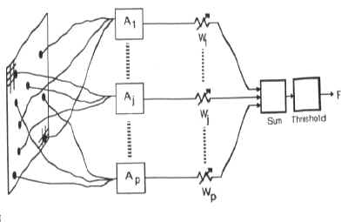
History
Perceptron (Rosenblatt 1958)
  Association units A₁, A₂, … extract features from user input
  Output is weighted and associated
  Function fires if weighted sum of input exceeds a threshold.

Slide 33
History
Back-propagation learning method (Werbos 1974)
  Three layers of neurons
    Input, Output, Hidden
  Better learning rule for generic three layer networks
  Regenerates interest in the 1980s
Successful applications in medicine, marketing, risk management.

Slide 34
Neural networks can be classified into several types based on their architecture and learning process. The main types are explained below:
1. Feedforward Neural Network (FNN)
Information flows only in one direction: from input layer → hidden layer(s) → output layer.
No feedback or loops.
Used in pattern recognition and classification.
Example: Perceptron, Multilayer Perceptron (MLP).
2. Convolutional Neural Network (CNN)
Specially designed for image and video processing.
Uses convolution, pooling, and fully connected layers.
Automatically extracts features from images.
Applications: image recognition, medical imaging, object detection.

Slide 35
3. Recurrent Neural Network (RNN)
Has feedback connections (loops).
Can store previous information (memory).
Suitable for sequential data.
Applications: speech recognition, time-series prediction, NLP.
Variants: LSTM (Long Short-Term Memory), GRU (Gated Recurrent Unit).
4. Radial Basis Function Network (RBFN)
Uses radial basis functions as activation functions.
Typically has three layers: input, hidden, and output.
Fast training and good for function approximation.

Slide 36
5. Artificial Neural Network (ANN)
General term for neural networks inspired by the human brain.
Includes feedforward, backpropagation networks, etc.
Used in classification, regression, and prediction problems.
6. Deep Neural Network (DNN)
Neural networks with multiple hidden layers.
Capable of learning complex patterns.
Used in speech recognition, AI systems, and robotics.

Slide 37
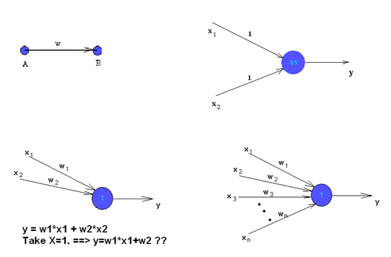
Artificial neurons

Slide 38
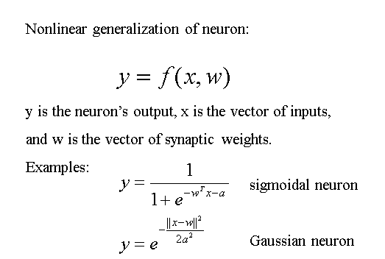
Artificial neurons

Slide 39
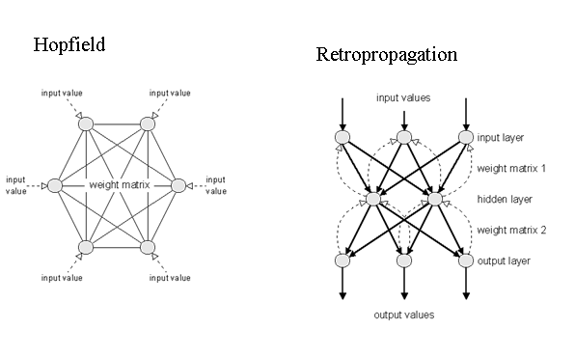
Other Model

Slide 40
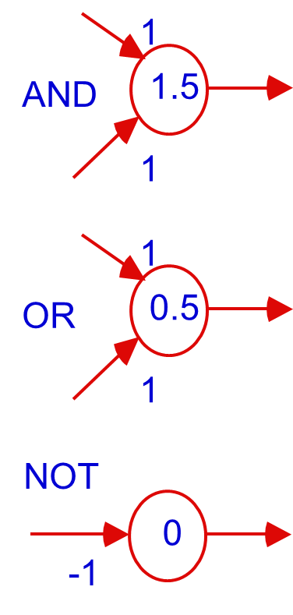
From Logical Neurons to Finite Automata

Slide 41
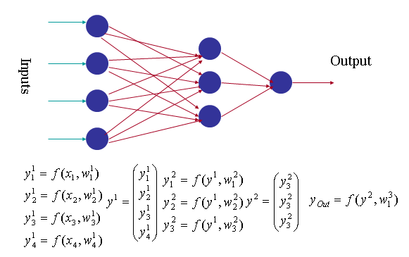
Neural network mathematics

Slide 42
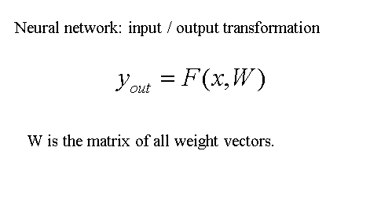
Neural network mathematics

Slide 43
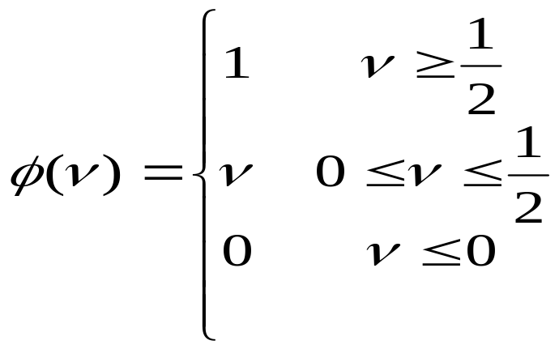
Neuron Model
Firing Rules:
  Threshold rules:
    Calculate weighted average of input
    Fire if larger than threshold
  Perceptron rule
    Calculate weighted average of input
    Output activation level is

Slide 44
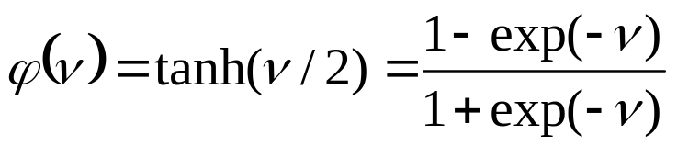
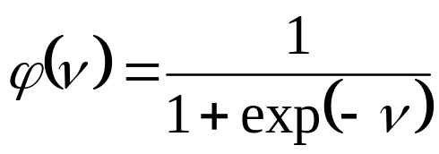
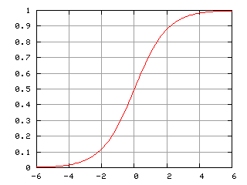
Neuron Model
Firing Rules: Sigmoid functions:
  Hyperbolic tangent function
  Logistic activation function

Slide 45
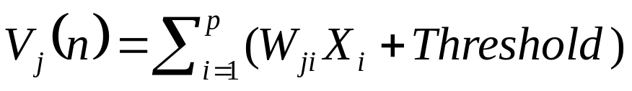
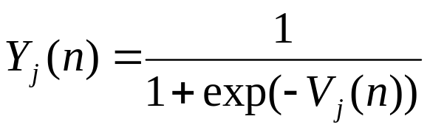
ANN Forward Propagation
Apply input vector X to layer of neurons.
Calculate
  where X_{i} is the activation of previous layer neuron i
  W_{ji} is the weight of going from node i to node j
  p is the number of neurons in the previous layer
Calculate output activation

Slide 46
ANN Forward Propagation
Example: ADALINE Neural Network
  Calculates and of inputs
0
w_{0,3}=.6
w_{1,3}=.6
threshold function is step function
1
3
2
w_{2,3}=-.9
Bias Node

Slide 47
ANN Forward Propagation
Example: Three layer network
  Calculates xor of inputs
-4.8
0
2
5.9
5.1
4
4.6
1
3
5.2
-5.2
-3.2
-2.6
-2.7
Bias

Slide 48
ANN Forward Propagation
Input (0,0)
-4.8
0
2
5.9
5.1
4
4.6
1
3
5.2
-5.2
-3.2
-2.6
-2.7
Bias

Slide 49
ANN Forward Propagation
Input (0,0)
  Node 2 activation is ϕ(-4.8 ⋅ 0+4.6 ⋅ 0 - 2.6)= 0.0691
-4.8
0
2
5.9
5.1
4
4.6
1
3
5.2
-5.2
-3.2
-2.6
-2.7
Bias

Slide 50
ANN Forward Propagation
Input (0,0)
  Node 3 activation is ϕ(5.1 ⋅ 0 - 5.2 ⋅ 0 - 3.2)= 0.0392
-4.8
0
2
5.9
5.1
4
4.6
1
3
5.2
-5.2
-3.2
-2.6
-2.7
Bias

Slide 51
ANN Forward Propagation
Input (0,0)
  Node 4 activation is ϕ(5.9 ⋅ 0.069 + 5.2 ⋅ 0.069 – 2.7)= 0.110227
-4.8
0
2
5.9
5.1
4
4.6
1
3
5.2
-5.2
-3.2
-2.6
-2.7
Bias

Slide 52
ANN Forward Propagation
Input (0,1)
  Node 2 activation is ϕ(4.6 -2.6)= 0.153269
-4.8
0
2
5.9
5.1
4
4.6
1
3
5.2
-5.2
-3.2
-2.6
-2.7
Bias

Slide 53
ANN Forward Propagation
Input (0,1)
  Node 3 activation is ϕ(-5.2 -3.2)= 0.000224817
-4.8
0
2
5.9
5.1
4
4.6
1
3
5.2
-5.2
-3.2
-2.6
-2.7
Bias

Slide 54
ANN Forward Propagation
Input (0,1)
  Node 4 activation is ϕ(5.9 ⋅ 0.153269 + 5.2 ⋅ 0.000224817 -2.7 )= 0.923992
-4.8
0
2
5.9
5.1
4
4.6
1
3
5.2
-5.2
-3.2
-2.6
-2.7
Bias

Slide 55
Learning principle for artificial neural networks
ENERGY MINIMIZATION
We need an appropriate definition of energy for artificial neural networks, and having that we can use mathematical optimisation techniques to find how to change the weights of the synaptic connections between neurons.
ENERGY = measure of task performance error

Slide 56
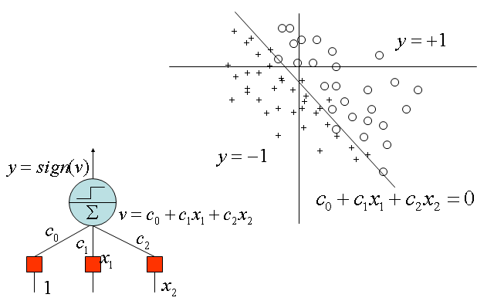
Perceptron application

Slide 57
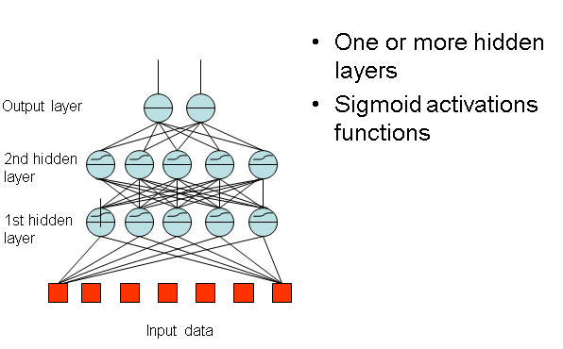
Multi-Layer Perceptron

Slide 58
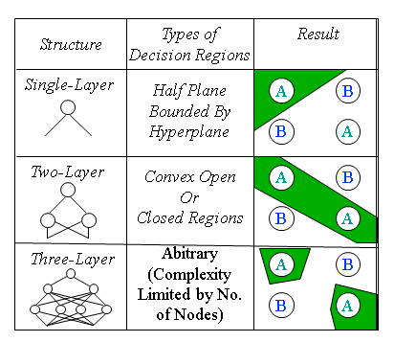
Multi-Layer Perceptron Application

Slide 59
NN have some disadvantages such as:
Preprocessing
Results interpretation by high dimension
Learning phase/Supervised/Non Supervised

Slide 60
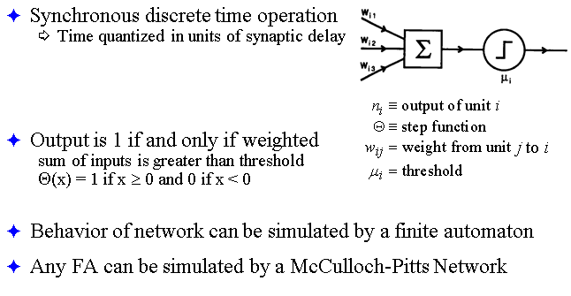
McCulloch–Pitts Neural Networks

Slide 61
Properties of Artificial Neural Networks
High level abstraction of neural input-output transformation
  Inputs → weighted sum of inputs → nonlinear function → output
    Typically no spikes
    Typically use implausible constraints or learning rules
Often used where data or functions are uncertain
  Goal is to learn from a set of training data
  And to generalize from learned instances to new unseen data
Key attributes
  Parallel computation
  Distributed representation and storage of data
  Learning (networks adapt themselves to solve a problem)
  Fault tolerance (insensitive to component failures)

Slide 62
Networks Types
Feedforward versus recurrent networks
  Feedforward: No loops, input → hidden layers → output
  Recurrent: Use feedback (positive or negative)
Continuous versus spiking
  Continuous networks model mean spike rate (firing rate)
    Assume spikes are integrated over time
  Consistent with rate-code model of neural coding
Supervised versus unsupervised learning
  Supervised networks use a “teacher”
    The desired output for each input is provided by user
  Unsupervised networks find hidden statistical patterns in input data
    Clustering, principal component analysis

Slide 63


Activation functions
Activation functions are mathematical functions used in neural networks to introduce non-linearity, decide neuron output, and help the network learn complex patterns.
Below are the main types of activation functions, explained simply (exam-oriented):
1. Binary Step Function
Use: Simple threshold-based decision.
Limitation: Not differentiable → not suitable for backpropagation.
2. Linear (Identity) Function
f(x) = x
Use: Output layer for regression problems.
Limitation: No non-linearity → network behaves like a single-layer model.

Slide 64


Activation functions
3. Sigmoid (Logistic) Function
Range: (0, 1)
Use: Binary classification, probability output.
Advantages: Smooth and differentiable.
Disadvantages: Vanishing gradient problem, slow learning.
4. Tanh (Hyperbolic Tangent) Function
Range: (−1, 1)
Advantages: Zero-centered output → better than sigmoid.
Disadvantages: Still suffers from vanishing gradient.

Slide 65

Activation functions
5. ReLU (Rectified Linear Unit)
f(x)=max⁡(0,x)
Use: Most commonly used in hidden layers.
Advantages: Fast computation, reduces vanishing gradient.
Disadvantages: Dying ReLU problem (neurons may stop activating).
6. Leaky ReLU
Advantage: Solves dying ReLU problem.
α: Small constant (e.g., 0.01).

Slide 66

Activation functions
7. Softmax Function
Use: Multi-class classification output layer.
Property: Outputs sum to 1 (probability distribution).

Slide 67
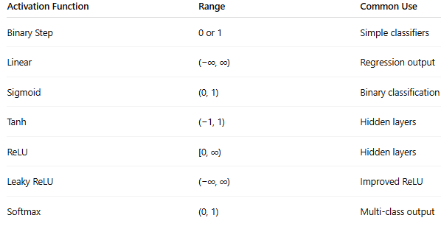
Activation functions

Slide 68

Factors Affecting Back Propagation
Back Propagation learning performance in neural networks depends on several factors:
Learning Rate (η)
  Controls the size of weight updates.
  Too high → unstable learning.
  Too low → slow convergence.
Initial Weights
  Poor initialization may lead to slow learning or local minima.
  Random small values are preferred.
Activation Function
Sigmoid and tanh may cause vanishing gradient.
ReLU improves convergence speed.

Slide 69
Factors Affecting Back Propagation
Network Architecture
Number of hidden layers and neurons affects learning capacity and accuracy.
Training Data Quality
Noisy or insufficient data reduces learning efficiency.
Momentum Term
Helps accelerate convergence and avoid local minima.
Number of Epochs
Too few → underfitting.
Too many → overfitting.
Error Surface / Local Minima
Complex error surfaces may trap learning in local minima.

Slide 70
Applications of Back Propagation Network
Back Propagation Networks are widely used in various fields:
Pattern Recognition
  Handwritten character and face recognition.
Speech Recognition
  Voice-controlled systems.
Image Processing
  Image classification and object detection.
Medical Diagnosis
  Disease prediction and analysis of medical data.
Forecasting
  Stock market and weather prediction.
Control Systems
  Robotics and industrial process control.
Data Mining
  Classification and clustering of large datasets.

Slide 71

Steps in Back Propagation Learning Algorithm
Back Propagation is a supervised learning algorithm used to train multilayer neural networks. The learning process consists of the following steps:
Step 1: Initialization
Initialize all weights and biases to small random values.
Choose learning rate (η) and stopping criteria (error limit or number of epochs).
Step 2: Input Pattern Presentation
Apply the input vector to the input layer.
Inputs are passed to the hidden layer neurons.

Slide 72


Steps in Back Propagation Learning Algorithm
Step 3: Forward Propagation
Compute the net input to each neuron:
Apply activation function to get output:
Repeat this process layer by layer until the output layer is reached.
Step 4: Error Computation
Compare actual output with desired output.
Calculate error:
where t_{k}​ is target output and y_{k}​ is actual output.

Slide 73

Steps in Back Propagation Learning Algorithm
Step 5: Backward Propagation of Error
Compute error gradient at the output layer:
Propagate error backward to hidden layers:
Step 6: Weight and Bias Update
Update weights using gradient descent:
Update biases similarly.

Slide 74
Steps in Back Propagation Learning Algorithm
Step 7: Iteration and Convergence
Repeat steps 2–6 for all training samples.
Continue for multiple epochs until:
  Error becomes minimum, or
  Maximum epochs are reached.
Step 8: Testing
After training, test the network using unseen data to evaluate performance.
Flow Summary
Initialize weights
Forward pass
Compute error
Backward pass
Update weights
Repeat until convergence

Slide 75

Types of Learning in Artificial Neural Networks (ANN)
Learning in ANN refers to the method by which a neural network adjusts its weights to improve performance. The main types of learning are explained below:
1. Supervised Learning
The network is trained using labeled data (input–output pairs).
Error is calculated by comparing actual output with desired output.
Weights are updated to minimize error.
Examples:
Back Propagation Network
Perceptron learning
Applications:
Pattern recognition
Classification and regression

Slide 76
Types of Learning in Artificial Neural Networks (ANN)
2. Unsupervised Learning
The network is trained using unlabeled data.
Learns patterns and structure automatically.
No target output is provided.
Examples:
Self-Organizing Maps (SOM)
Competitive learning
Applications:
Clustering
Data compression

Slide 77
Types of Learning in Artificial Neural Networks (ANN)
3. Reinforcement Learning
Learning is based on feedback from the environment.
Uses reward and penalty instead of exact target values.
Learner improves by trial and error.
Examples:
Q-learning
Actor–Critic models
Applications:
Robotics
Game playing

Slide 78
Types of Learning in Artificial Neural Networks (ANN)
4. Semi-Supervised Learning
Uses both labeled and unlabeled data.
Useful when labeled data is limited.
Applications:
Speech recognition
Image classification
5. Online Learning
Weights are updated after each input sample.
Suitable for real-time systems.
6. Batch Learning
Weights are updated after processing the entire dataset.
Stable but slower compared to online learning.

Slide 79

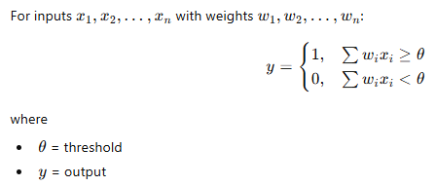
McCulloch–Pitts (M–P) Neuron Model
The McCulloch–Pitts model is the earliest artificial neuron model, proposed to explain how a biological neuron works using a binary threshold logic unit.
Basic Concept
Inputs are binary (0 or 1)
Weights are fixed
Uses a threshold activation function
Output is binary (0 or 1)
Mathematical Model

Slide 80
McCulloch–Pitts (M–P) Neuron Model
Assumptions of M–P Model
Inputs and outputs are binary.
Weights are constant.
No learning mechanism.
Single neuron decision-making.

Slide 81
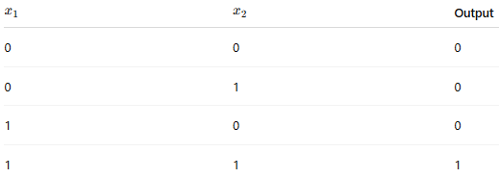


McCulloch–Pitts (M–P) Neuron Model
Realization of AND Gate using M–P Neuron:
Truth Table (AND Gate)

Slide 82
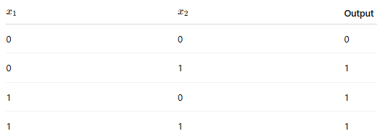


McCulloch–Pitts (M–P) Neuron Model
Realization of OR Gate using M–P Neuron:
Truth Table (OR Gate)

Slide 83
McCulloch–Pitts (M–P) Neuron Model
Advantages
Simple and easy to understand
Basis for modern neural networks
Limitations
Cannot learn (no weight update)
Cannot solve non-linearly separable problems (e.g., XOR)

Slide 84
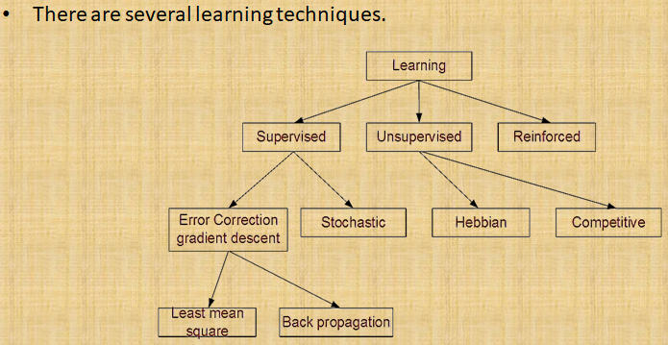
Types of learning

Slide 85
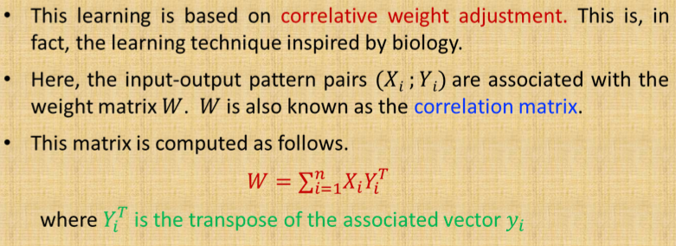
Hebbian learning

Slide 86
Hebbian learning
Principle: This rule is based on the biological concept that "neurons that fire together, wire together.
Hebbian Learning Rule is an unsupervised learning algorithm used in neural networks to adjust the weights between nodes. It is based on the principle that the connection strength between two neurons should change depending on their activity patterns.
The rule can be summarized as follows:
When two neighboring neurons operate in the same phase at the same time, the weight between them increases.
If the neurons operate in opposite phases, the weight between them decreases.
When there is no signal correlation between the neurons, the weight remains unchanged.

Slide 87
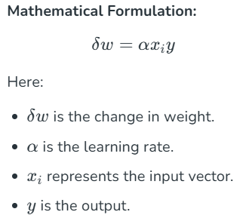
Hebbian learning
The sign of the weight between two nodes is determined by the sign of their input signals:
If both nodes receive inputs that are either positive or negative, the resulting weight is strongly positive.
If one node's input is positive while the other's is negative, the resulting weight is strongly negative.

Slide 88
Perception learning rule
Principle: This rule adjusts weights to minimize classification errors.
Perceptron Learning Rule is an error-correcting algorithm designed for single-layer feedforward networks. It is a supervised learning approach that adjusts weights based on the error calculated between the desired and actual outputs. Weight adjustments are made only when an error is present.
The Perceptron Rule is an algorithm used to train a perceptron, the simplest type of artificial neural network, designed for binary classification tasks. It adjusts the weights assigned to the input features based on the errors made in predictions. This allows the perceptron to improve its ability to distinguish between two classes over time, learning the optimal decision boundary between them.

Slide 89
Perception learning rule
Rule :
1. Initialization:
Weights and Bias: Start by initializing the weights (parameters that determine the importance of each input feature) and the bias (a threshold value) to small random values or zeros.
Learning Rate (η): Choose a learning rate that controls the magnitude of weight updates. A common choice is a small positive value like 0.01.

Slide 90
Perception learning rule
2. Training Process:
Input Presentation: Present each training example to the perceptron one at a time.
Weighted Sum Calculation: For each input vector (x), calculate the weighted sum:
z = w . x + b
where (w) is the weight vector, (x) is the input vector, and (b) is the bias.

Slide 91


Perception learning rule
Activation Function: Apply the activation function (typically a step function) to determine the predicted output y_{pred}
Error Calculation: Compute the error by comparing the predicted output y_{pred} with the actual target y :
Weight and Bias Update: If there is an error (i.e., y ≠ y_{pred}), update the weights and bias to reduce the error:
This adjustment moves the decision boundary in a direction that reduces the classification error for the current example.

Slide 92
Perception learning rule
3. Iteration:
Repeat the training process for multiple epochs (complete passes through the training dataset) until the perceptron correctly classifies all training examples or until a maximum number of epochs is reached.
Key Characteristics of the Perceptron Rule:
Linear Separability: The perceptron rule guarantees convergence only if the two classes are linearly separable, meaning there exists a straight line (in two dimensions) or a hyperplane (in higher dimensions) that can perfectly separate the classes.
Online Learning: The rule updates weights incrementally for each training example, making it suitable for online learning scenarios where data arrives sequentially.
Simplicity: Its straightforward update mechanism makes the perceptron rule easy to implement and understand, serving as a building block for more complex neural network training algorithms.

Slide 93
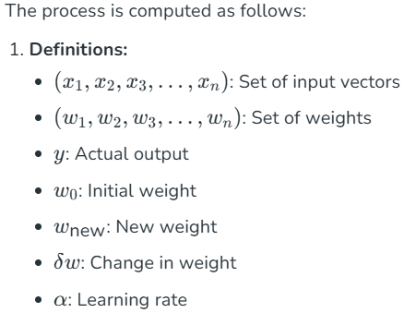
Perception learning rule

Slide 94
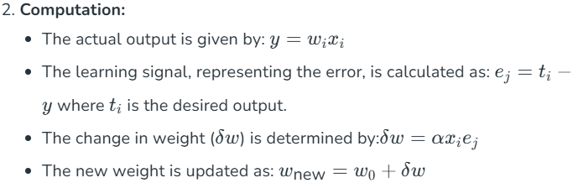
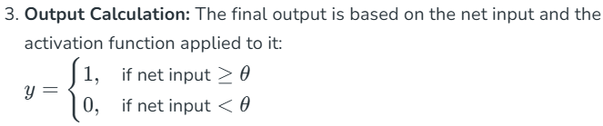
Perception learning rule

Slide 95
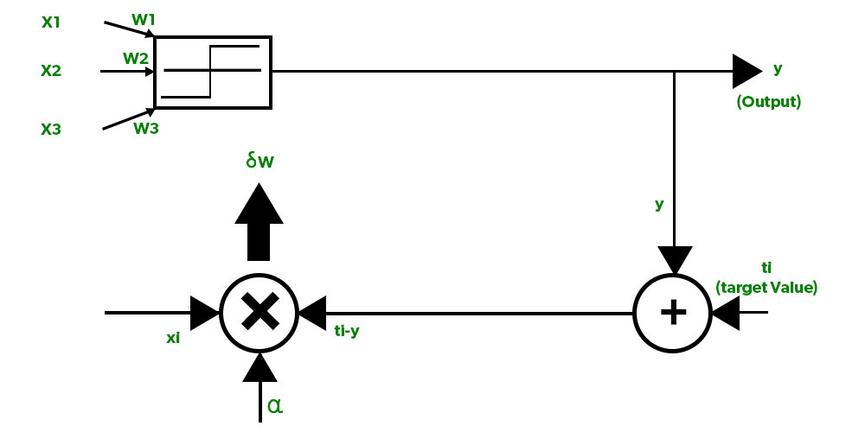
Perception learning rule
This rule provides the foundation for learning in perceptrons, enabling them to make adjustments and improve performance iteratively.

Slide 96
Delta learning rule
Principle: Minimizes the error between the actual output and the desired output using gradient descent.
Delta Learning Rule is a supervised learning algorithm that uses a continuous activation function. Also known as the Least Mean Square (LMS) method, it aims to minimize the error across all training patterns. This rule is based on the gradient descent approach, which iteratively reduces error by updating the weights of the network.

Slide 97
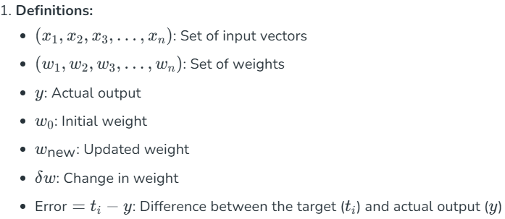
Delta learning rule
Computed as follows:

Slide 98
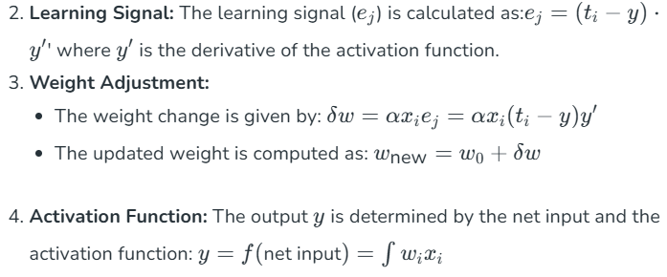
Delta learning rule

Slide 99
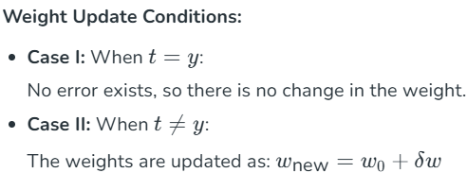
Delta learning rule
This method ensures that weights are updated only when an error is present, driving the network toward reducing the overall error in successive iterations.

